Slide 1
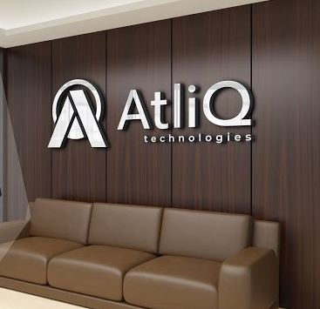
Consumer Goods
AD-Hoc Request
Codesbascis Project Challenge
Presented by Mayank Singh

Slide 2
Table of contents
Project Summary
Understanding the Dataset
Atliq Product Lines
Ad-Hoc Request
You can simply impress your audience and add a unique zing and appeal to your Presentations. I hope and I believe that this Template will your Time, Money and Reputation.
You can simply impress your audience and add a unique zing and appeal to your Presentations. I hope and I believe that this Template will your Time, Money and Reputation.
You can simply impress your audience and add a unique zing and appeal to your Presentations. I hope and I believe that this Template will your Time, Money and Reputation.
You can simply impress your audience and add a unique zing and appeal to your Presentations. I hope and I believe that this Template will your Time, Money and Reputation.

Slide 3
Project Summary
1
01
About Company
Atliq Hardware (an imaginary company) is one of India's leading computer hardware producers and has a business well spread in 27 countries across the globe. It has customers in the region like North America (NA), Latin America(LATAM), and Asia-Pacific(APAC)
02
Problem Statement
The management team of the company has identified a need for timely and informed decision-making based on data insights. Consequently, they have requested the data analytics team, to provide ad-hoc solutions to 10 specific problems in order to gain the required insights
03
Objective
The task at hand involves executing SQL queries to address 10 significant ad hoc inquiries that provide essential business insights. The intended recipients of the resulting presentation are high-level executives, requiring a thorough and precise depiction of the insights to aid in making critical business decisions.

Slide 4
Understanding the Dataset
2
Dim_customer
Dim_product
Fact_gross_price
fact_manufacturing_prcie
Fact_pre_invoice_deductions
Fact_sales_montly
Description
Description
Description
Description
Description
Description
Contain Customer related data.
Contain product-related data
Contain gross price information for each product.
Contain cost incurred in the production of each product.
Contains pre_invoice deduction information for each product.
Contain monthly sales data for each product.
Simple PowerPoint Presentation
Dimension Table
Fact Table
Fact Table
Fact Table
Fact Table
Dimension Table

Slide 5
Atliq Product Lines
3
Division
PC
P&A
N&S
Segment
Desktop
Notebook
Peripherals
Accessories
Networking
Storage
Business
Desktop
Gaming Laptop
Graphic Card
Batteries
Wi-Fi Extender
External HDD
Category
Personal Desktop
Business Laptop
Internal HDD
Keyboard
USB Flash Drivers
Personal Laptop
Motherboard
Mouse
Processors

Slide 6

Ad hoc Requests
4

Slide 7
market
India
Indonesia
Japan
Philippines
South Korea
Australia
New Zealand
Bangladesh
Request 1
List of markets in which customer “Atliq Exclusive” operates its business in the APAC region.

Slide 8
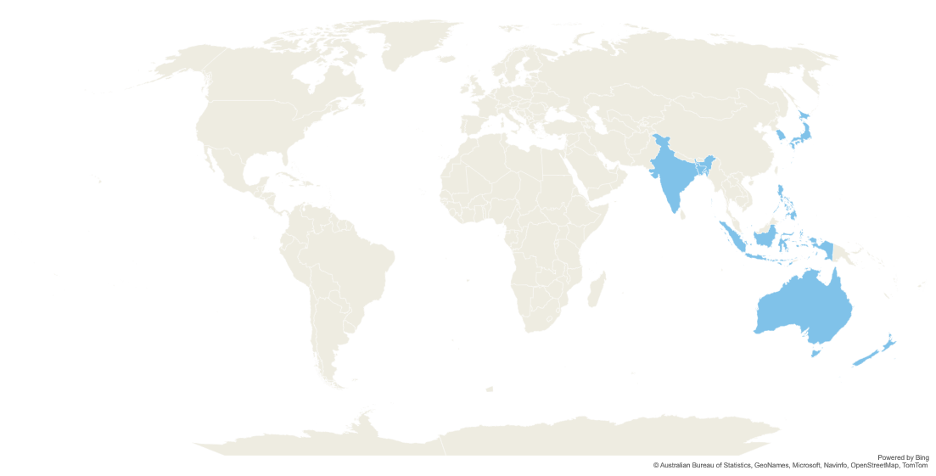
Important Insights
South Korea
Japan
“Atliq Exclusive” operates its business in 8 countries of the APAC Region. APAC stands for Asia-Pacific.
The Philippines
INDIA
Bangladesh
Australia
Indonesia
New Zealand

Slide 9
unique_products_2020 | unique_products_2021 | Percentage chg
245 | 334 | 36.33
Request 2
Percentage of unique product increase in 2021 vs 2020.

Slide 10
Important Insights
Atliq Hardware saw a significant rise of 36.33% in the number of unique products recorded in 2021, with 334 products, compared to 245 products in 2020.
This increase suggests that Atliq Hardware remains competitive through the introduction of new products.
Atliq Hardware is committed to enhancing its revenue by enhancing the strengths of its existing products and developing high-demand products.
To sustain growth and expand its market share, Atliq Hardware should prioritize product development

Slide 11
Segment | Product count
Notebook | 129
Accessories | 116
Peripherals | 84
Desktop | 32
Storage | 27
Networking | 9
Request 3
Total Number of Unique Products for each Segment.

Slide 12
Important Insights
The highest contributing segment to sales is Notebook, Accessories, and Peripherals, whereas the lowest contributing segment is Desktop, Storage, and Networking.
The average sales of the top 3 contributors were (109.66), while the average sales of the bottom 3 contributors were (22.6).
To sustain production levels, Atliq Hardware should prioritize allocating resources to the top-performing segments.
In addition to that, Atliq Hardware should investigate why Desktop, Storage, and Networking have fewer unique products and develop strategies to increase their sales, which would lead to market expansion and revenue growth.

Slide 13
segment | 2020 | 2021 | difference
Accessories | 69 | 103 | 34
Notebook | 92 | 108 | 16
Peripherals | 59 | 75 | 16
Desktop | 7 | 22 | 15
Storage | 12 | 17 | 5
Networking | 6 | 9 | 3
Request 4
The segment that had the most increase in unique products in 2020 vs 2021

Slide 14
Important Insights
There has been a significant surge in the number of unique products in the accessories segment, with the addition of 34 new unique products.
The notebook and peripherals segments have also witnessed an increase in unique products, with each segment adding 16 new unique products.

Slide 15
product code | product | Manufacturing cost
A2118150101 | AQ Master wired x1 Ms | 0.892
A6120110206 | AQ HOME Allin1 Gen 2 | 240.5364
Request 5
The Product that had the highest and lowest manufacturing cost.

Slide 16

Product with the highest and lowest manufacturing cost.
The personal desktop, Product AQ HOME Allin1 Gen 2, incurs the highest manufacturing cost among all the products.
Among all the products, the manufacturing cost of Product AQ Master wired x1 Ms, a wired mouse, is the lowest.

Slide 17
Customer code | customer | Average discount percentage
90002009 | Flipkart | 30.83
90002006 | Viveks | 30.38
90002003 | Ezone | 30.28
90002002 | Croma | 30.25
90002016 | Amazon | 29.33
Request 6
Top 5 customers who received an average high pre-invoice discount percent for the fiscal year 2021 and in the Indian market.

Slide 18
Important Insights
The company's pre-invoice discount remained consistent for its top 5 customers in 2021, with a difference of only 1.5% between the highest and lowest discount received.
This could be a deliberate strategy on Atliq Exclusive's part to maintain parity between its major customers and ensure that none of them feel they are receiving a better or worse deal than the others.
Among these customers, Flipkart received the highest discount, followed by Viveks. while Amazon received the lowest discount in the Indian market.
It is worth noting, however, that the discount percentage being offered is quite high across the board, with all of Atliq Exclusive's major customers receiving discounts of over 29%. This could suggest that Atliq Exclusive is facing pressure from its competitors and needs to offer significant discounts in order to remain competitive.

Slide 19
month | 2021 | 2020
November | 32247289.79 | 15231895
October | 21016218.21 | 10378638
December | 20409063.18 | 9755795.1
January | 19570701.71 | 9584951.9
September | 19530271.3 | 9092670.3
May | 19204309.41 | 1586964.5
March | 19149624.92 | 766976.45
July | 19044968.82 | 5151815.4
February | 15986603.89 | 8083995.6
June | 15457579.66 | 3429736.6
April | 11483530.3 | 800071.95
August | 11324548.34 | 5638281.8
Request 7
Gross Sales Amount for “Atliq Exclusive” for each month in 2020 and 2021.

Slide 20
Important Insights
2021
2020
Sales Growth
Seasonal Trend
The gross sales of Atliq Exclusive have shown significant growth in 2021 compared to 2020. In particular, Q1 and Q3 of 2021 have seen a substantial increase in sales compared to the same quarter in 2020. This could be due to several factors, including an increase in consumer demand or effective marketing and sales strategies.
There appears to be a seasonal trend in the gross sales of Atliq Exclusive, with higher sales during the months of September to November, which fall in Q1, and lower sales during the months of March to May, which fall in Q3. This trend may be due to various reasons, including seasonal shopping trends or market conditions.
1
2
Monthly Variations
Impact of Covid-19
There are significant variations in gross sales from month to month, with some months showing much higher sales than others. For example, November 2020 and November 2021 both had much higher sales than the preceding months, which may indicate successful promotions or marketing campaigns during that period.
The data shows that Atliq Exclusive experienced a significant dip in sales during the months of March and April 2020, which may have been due to the COVID-19 pandemic and related lockdowns. However, the sales rebounded in the later months of 2020 and continued to grow in 2021.
4
3

Slide 21
Quarter | Total Sold Quantity
Q1 | 7005619
Q2 | 6649642
Q4 | 5042541
Q3 | 2075087
Request 8
Maximum total sold quantity in 2020 quarter-wise.

Slide 22
Important Insights
The total sold quantity increased significantly in Q4 compared to Q3, indicating a strong finish to the year for Atliq Exclusive. This could be due to various reasons, including effective marketing and sales strategies or seasonal shopping trends.
The total sold quantity of Atliq Exclusive during 2020 is highest during Q1, followed by Q4, Q2, and Q3, respectively. This suggests that Q1 was the strongest quarter for Atliq Exclusive in terms of sales.
Overall, the data suggests that Atliq Exclusive's total sold quantity showed seasonal trends, with higher sales during Q1 and Q4, and lower sales during Q2 and Q3. The comparison of sales across quarters shows that Q1 was the strongest quarter for Atliq Exclusive in terms of sales.

Slide 23
channel | Gross sales Mn | percentage
Retailer | 1219.08M | 73.23%
Direct | 257.53M | 15.47%
Distributor | 188.03M | 11.30%
Request 9
Channel that contributes to most gross sales in million in 2021 and their percentage of contribution.

Slide 24
Important Insights
The Retailer channel has contributed the highest gross sales of 1219.08 million, which is 73.22% of the total sales. This indicates that the Retailer channel is the most significant contributor to the sales of Atliq Exclusive in 2021.
.
The Direct and Distributor channels together have contributed around 26.79% of the total sales, which shows that Atliq Exclusive also depends on these channels to a significant extent.
The Retailer channel has contributed more than two-thirds of the total sales, which indicates that Atliq Exclusive heavily relies on this channel for its sales.
Overall, the data suggest that the Retailer channel is the most important channel for Atliq Exclusive in terms of gross sales contribution, and the company needs to maintain a strong relationship with this channel to continue its growth and success.

Slide 25
division | Product code | product | Total sold quantity | Rank order
N & S | A6720160103 | AQ Pen Drive 2 IN 1 Premium | 701373 | 1
N & S | A6818160202 | AQ Pen Drive DRC Plus | 688003 | 2
N & S | A6819160203 | AQ Pen Drive DRC Premium | 676245 | 3
P & A | A2319150302 | AQ Gamers Ms Standard 2 | 428498 | 1
P & A | A2520150501 | AQ Maxima Ms Standard 1 | 419865 | 2
P & A | A2520150504 | AQ Maxima Ms Plus 2 | 419471 | 3
PC | A4218110202 | AQ Digit Standard Blue | 17434 | 1
PC | A4319110306 | AQ Velocity Velocity Plus Red | 17280 | 2
PC | A4218110208 | AQ Digit Digit Premium Misty Green | 17275 | 3
Request 10
Top 3 products in each division that has the highest told sold quantity in the fiscal year 2021.

Slide 26
Important Insights
Based on the provided data, it is clear that “Atliq Exclusive” products have been well-received in the market with high total sold quantities across all divisions.
Finally, in the PC division, the AQ Digit Standard Blue, AQ Velocity Velocity Plus Red, and AQ Digit Digit Premium Misty Green were the top 3 products with the highest total sold quantity, suggesting a strong demand for high-quality computer accessories in this division.
Network & Storage (N&S)
In the N & S division, the AQ Pen Drive 2 IN 1 Premium, AQ Pen Drive DRC Plus, and AQ Pen Drive DRC Premium were the top 3 products with the highest total sold quantity. Indicating a strong demand for premium-quality pen drives in this division.
Overall, these insights provide us with valuable information about “Atliq Exclusive” customers' preferences and the products that are performing well in the market.
Peripherals and Accessories (P&A)
Similarly, in the P & A division, the AQ Gamers Ms Standard 2, AQ Maxima Ms Standard 1, and AQ Maxima Ms Plus 2 were the top 3 products with the highest total sold quantity, highlighting the popularity of gaming mouse in this division.
It is crucial for “Atliq Exclusive” to continue to invest in these products and further improve their quality to meet the evolving needs of our customers.
Personal Computer (P&C)

Slide 27





Dhaval Patel
Hemanand Vadivel
THANK YOU

Slide 28
Atliq Exclusive Consumer Goods
Python, Pandas, Seaborn
Presented by
Mayank Singh

Slide 29
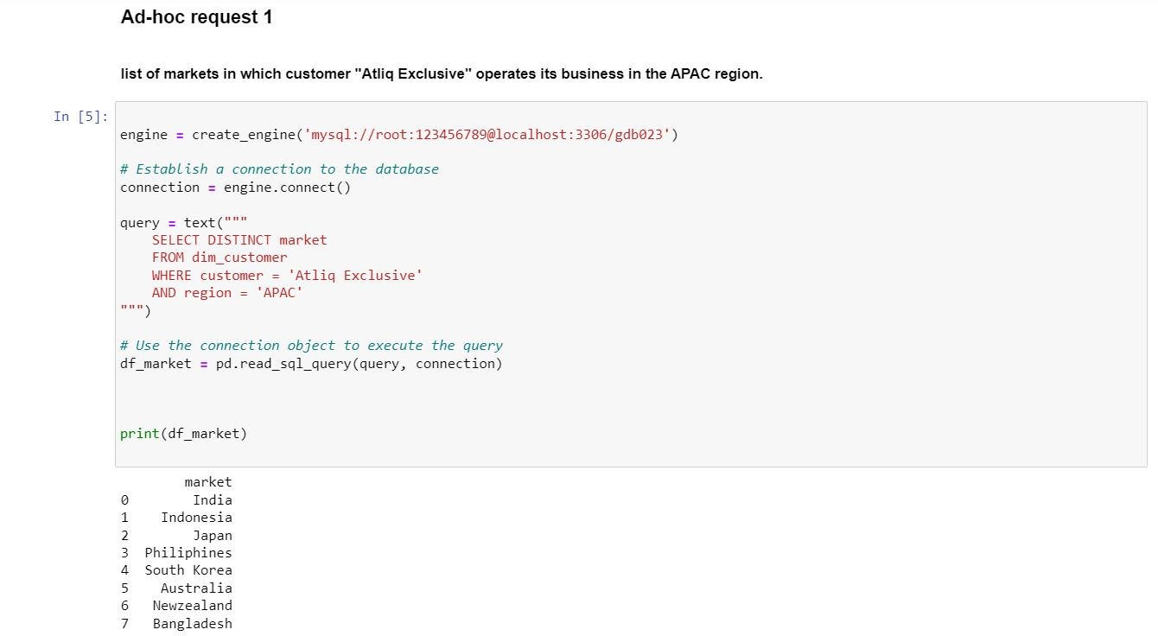
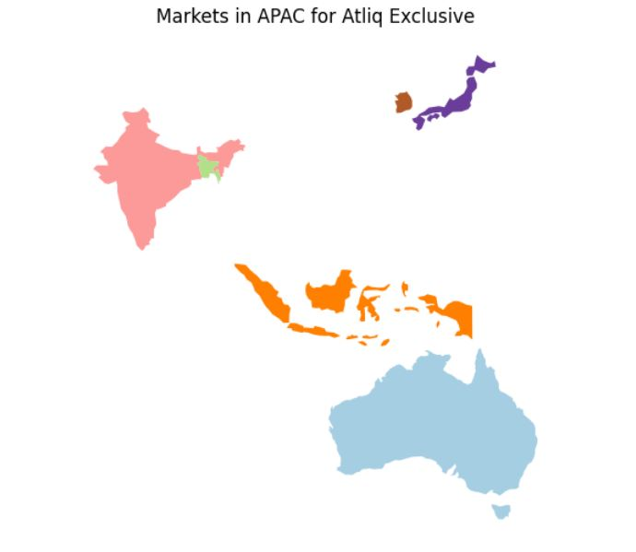

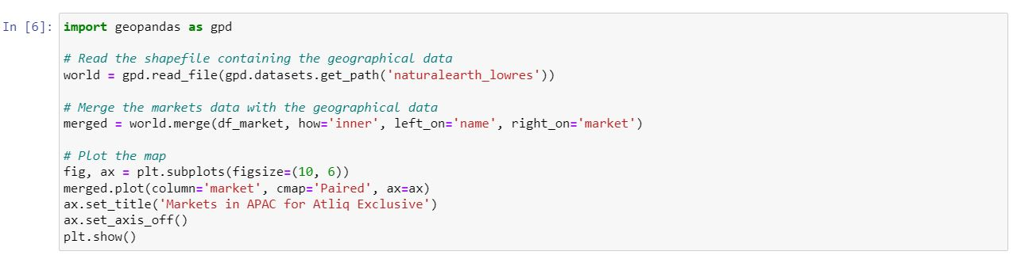

Slide 30
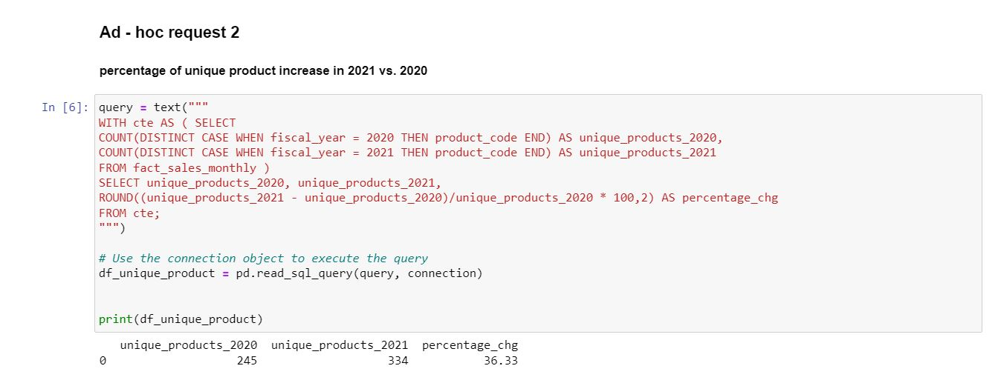
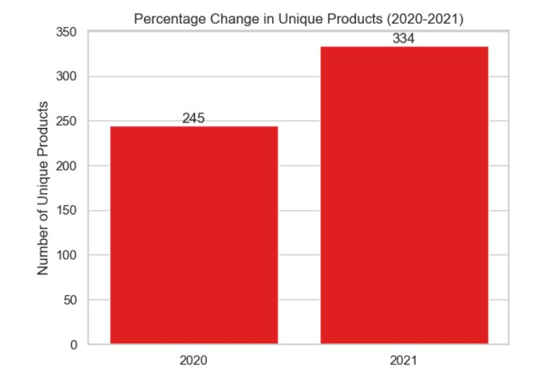
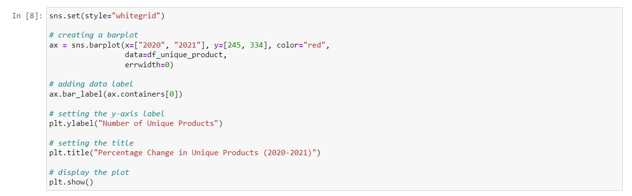

Slide 31
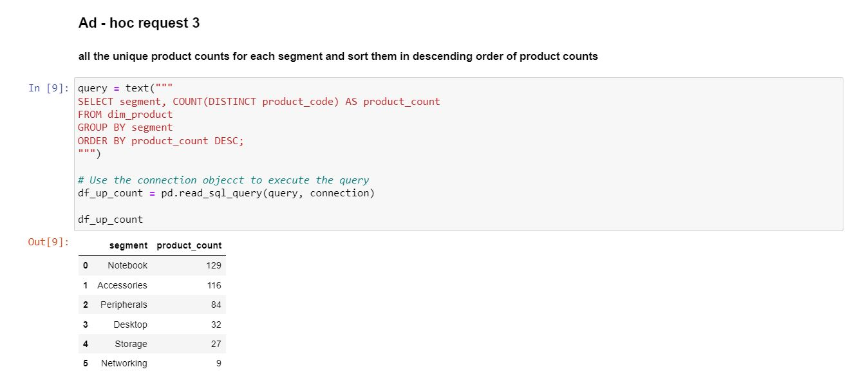
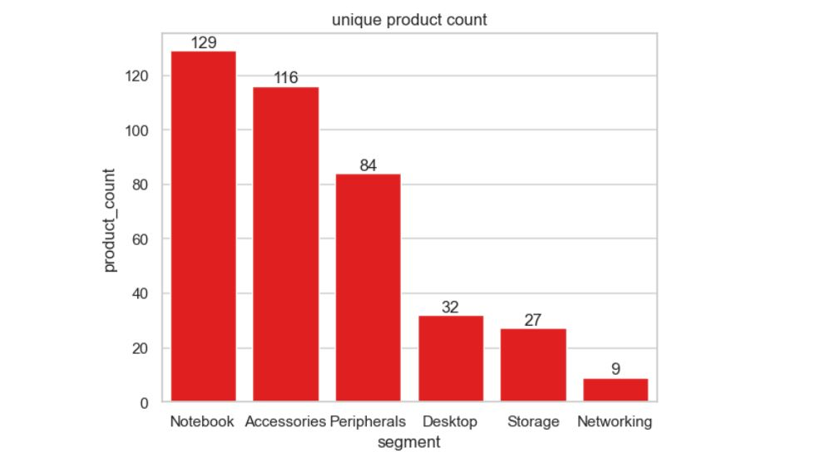
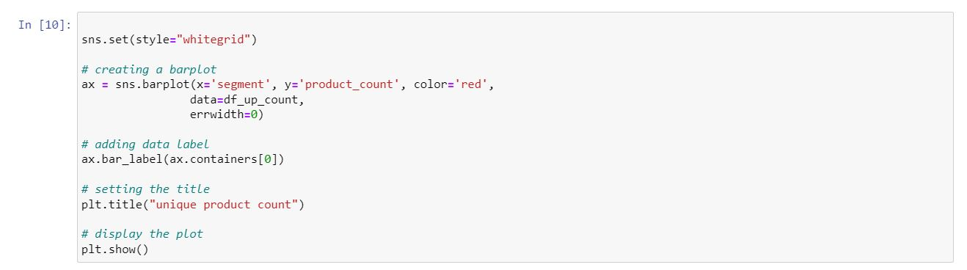

Slide 32
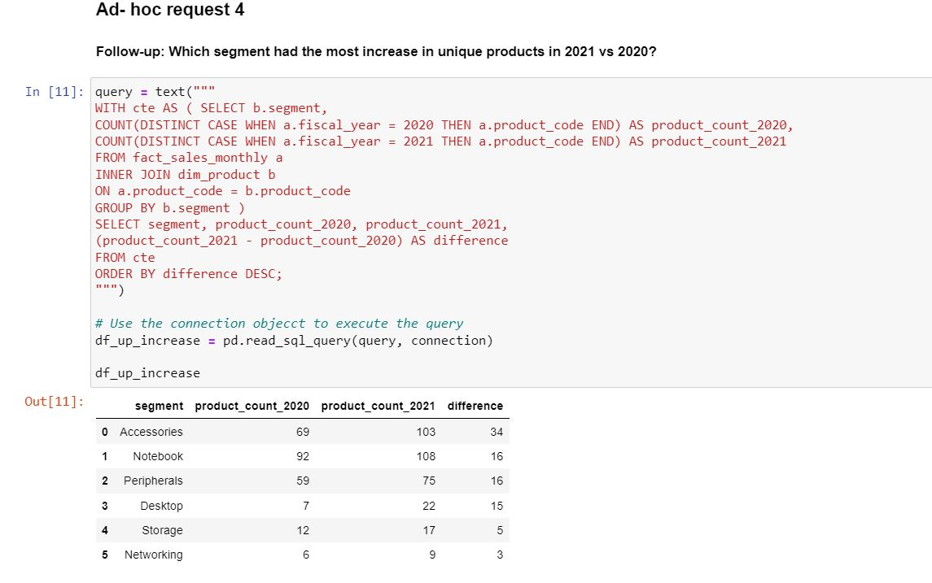
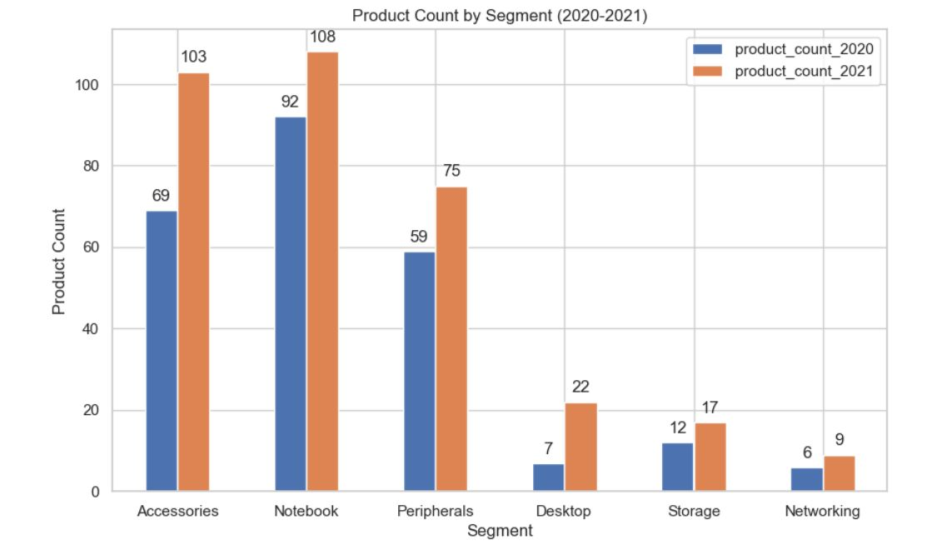
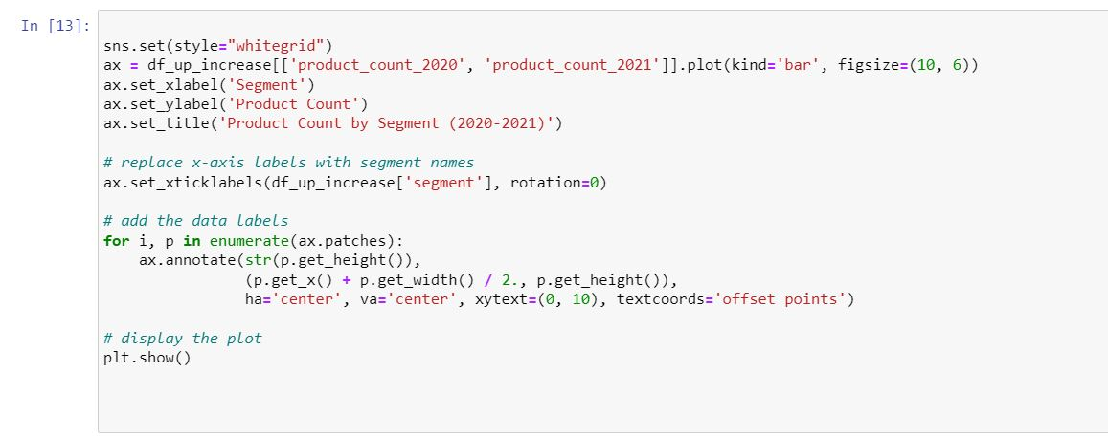

Slide 33
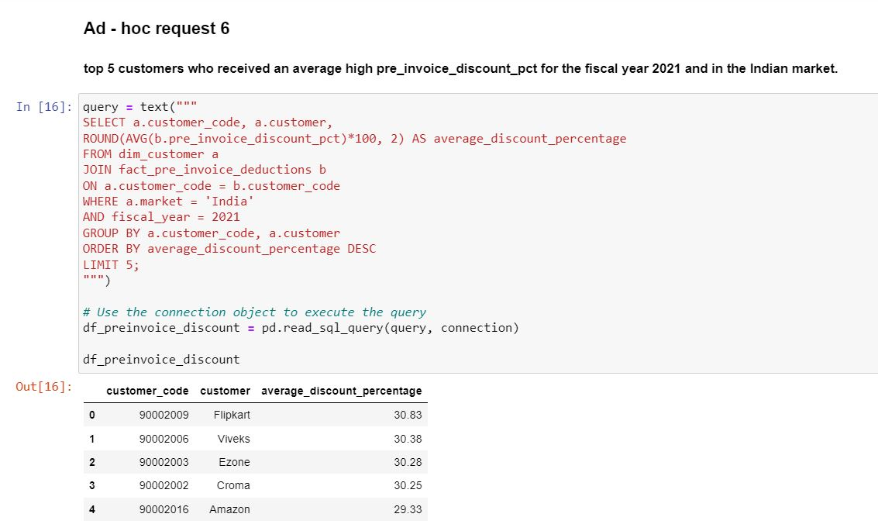
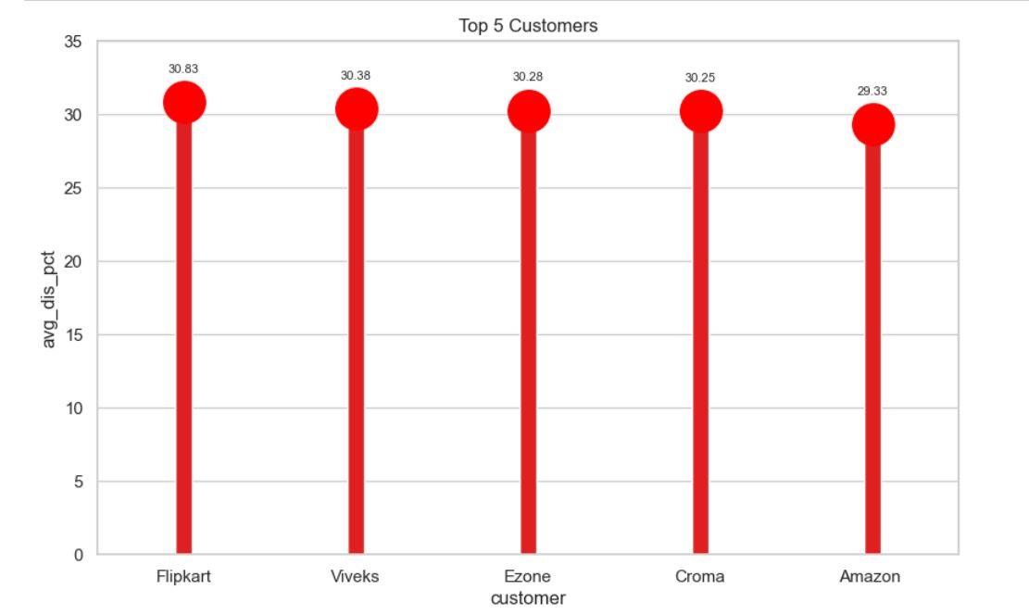
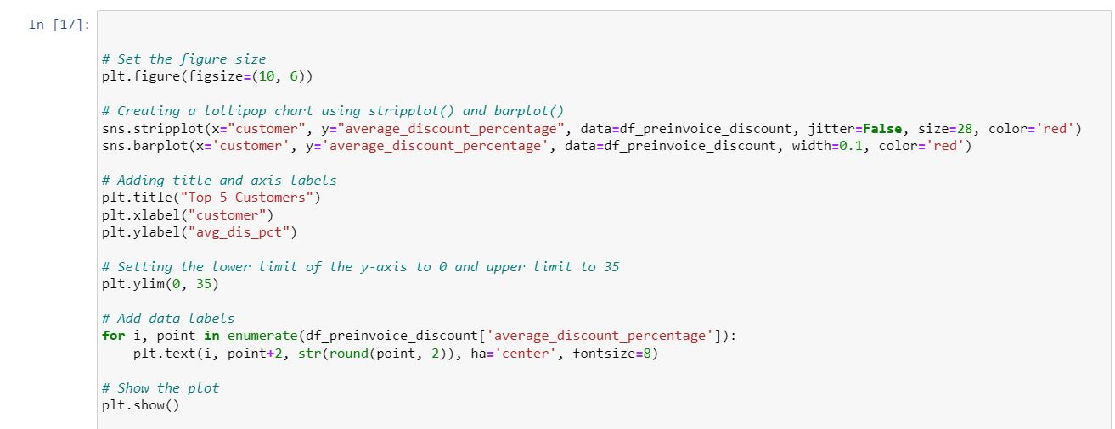

Slide 34
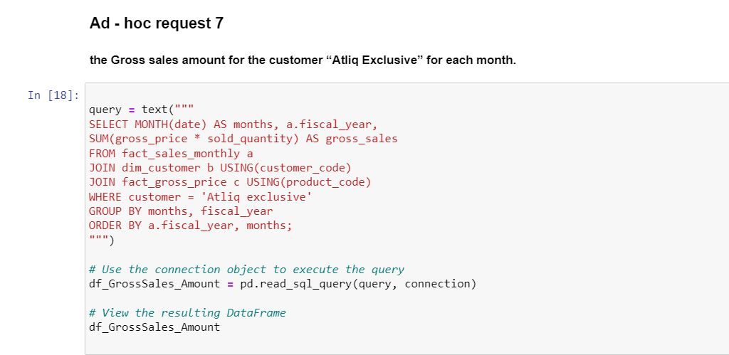
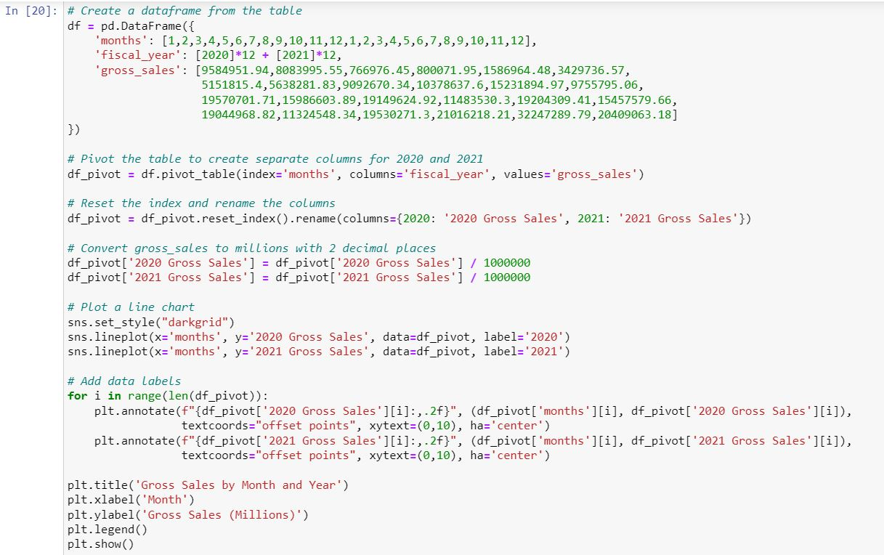
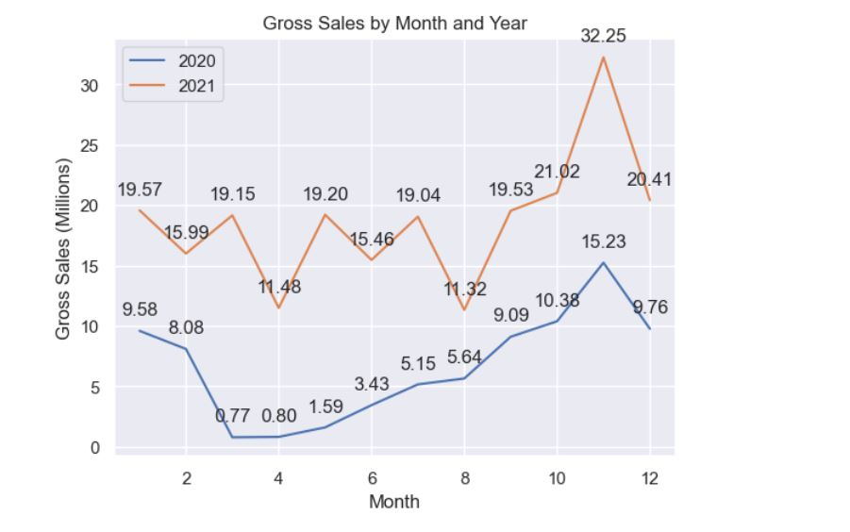

Slide 35
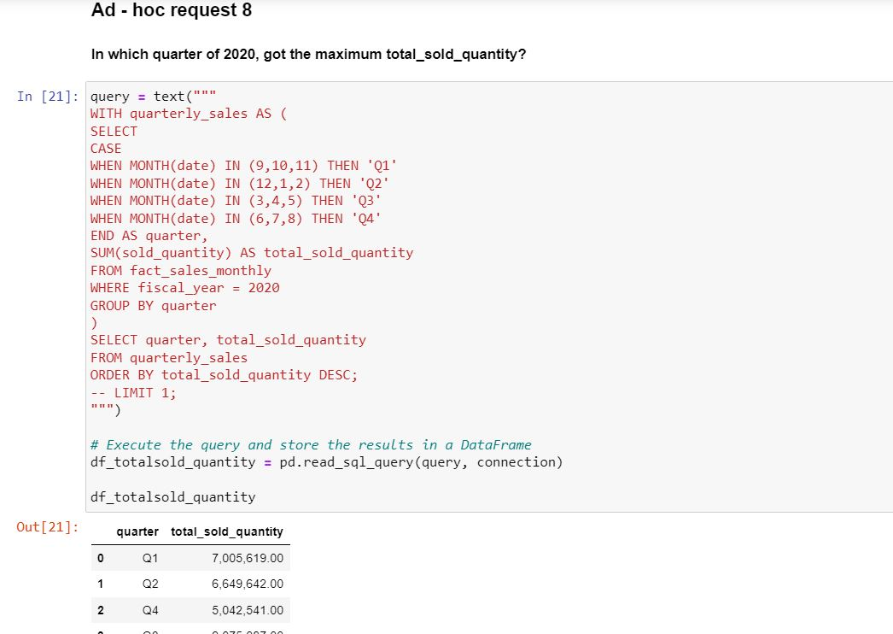
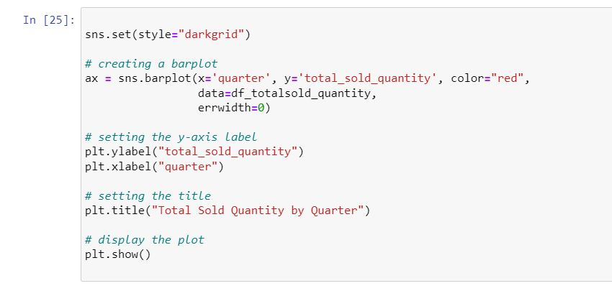
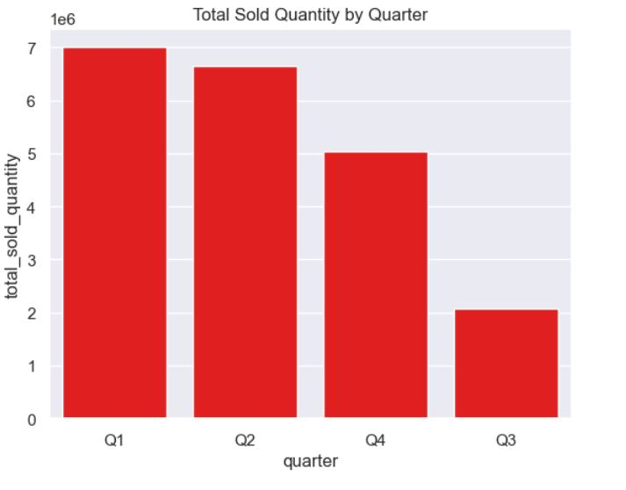

Slide 36
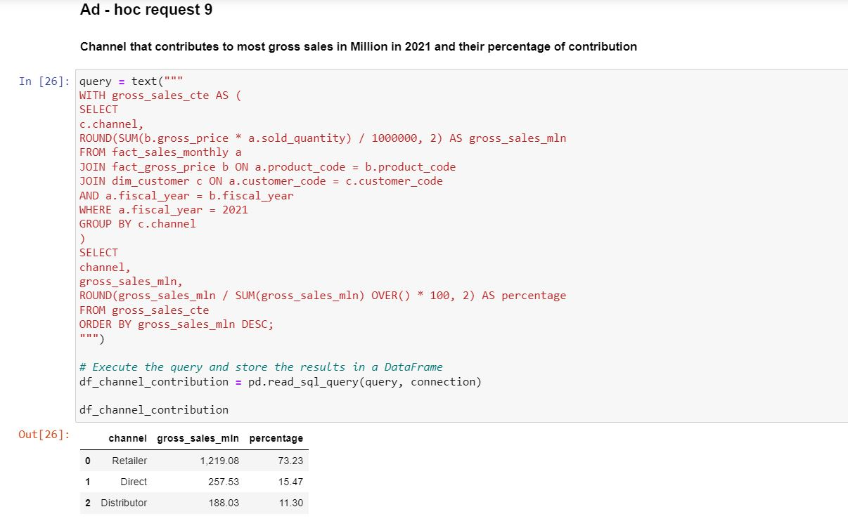
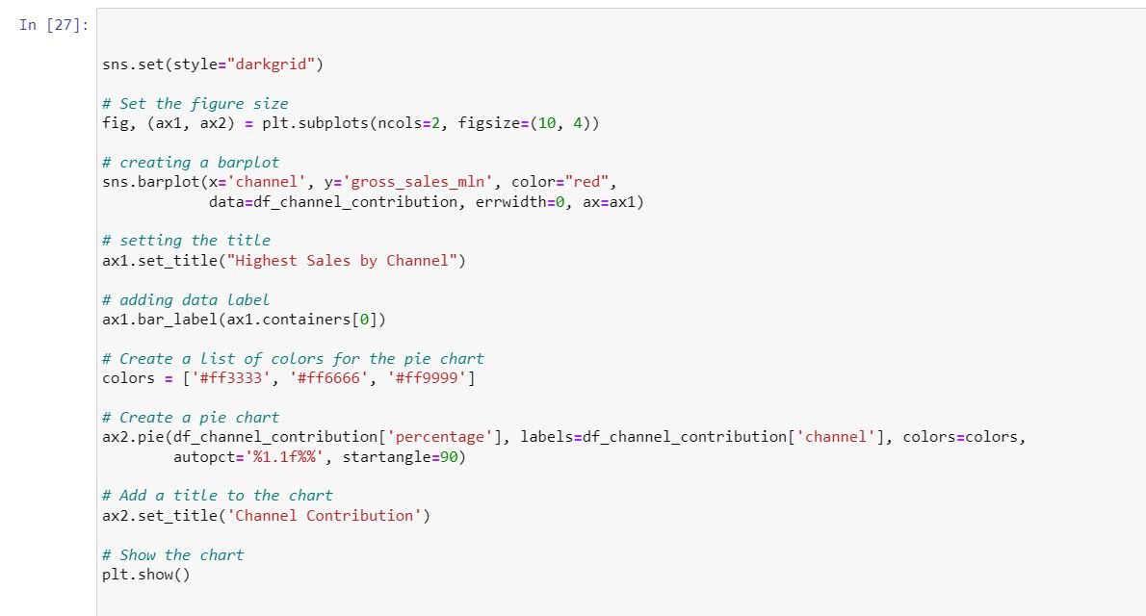
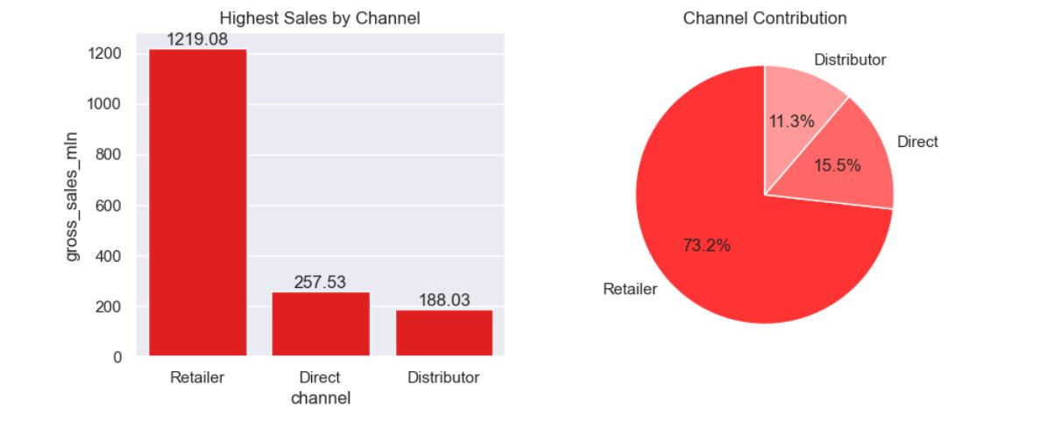

Slide 37
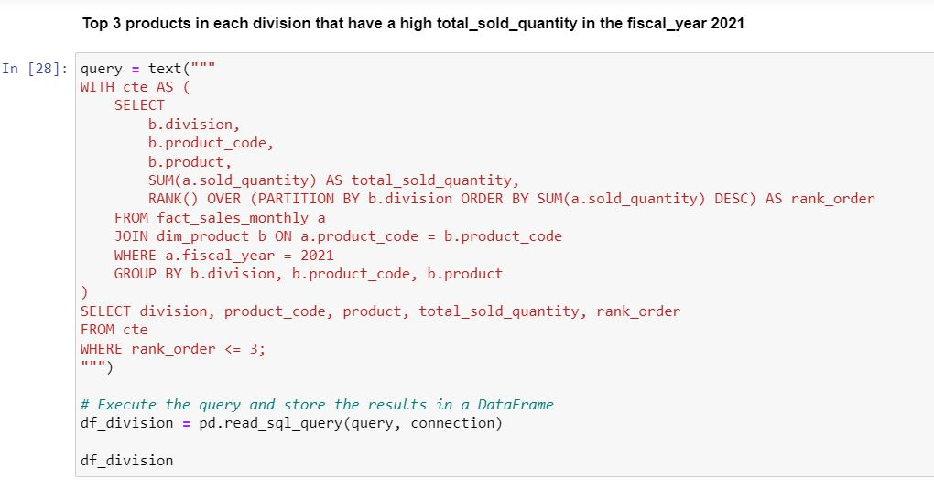
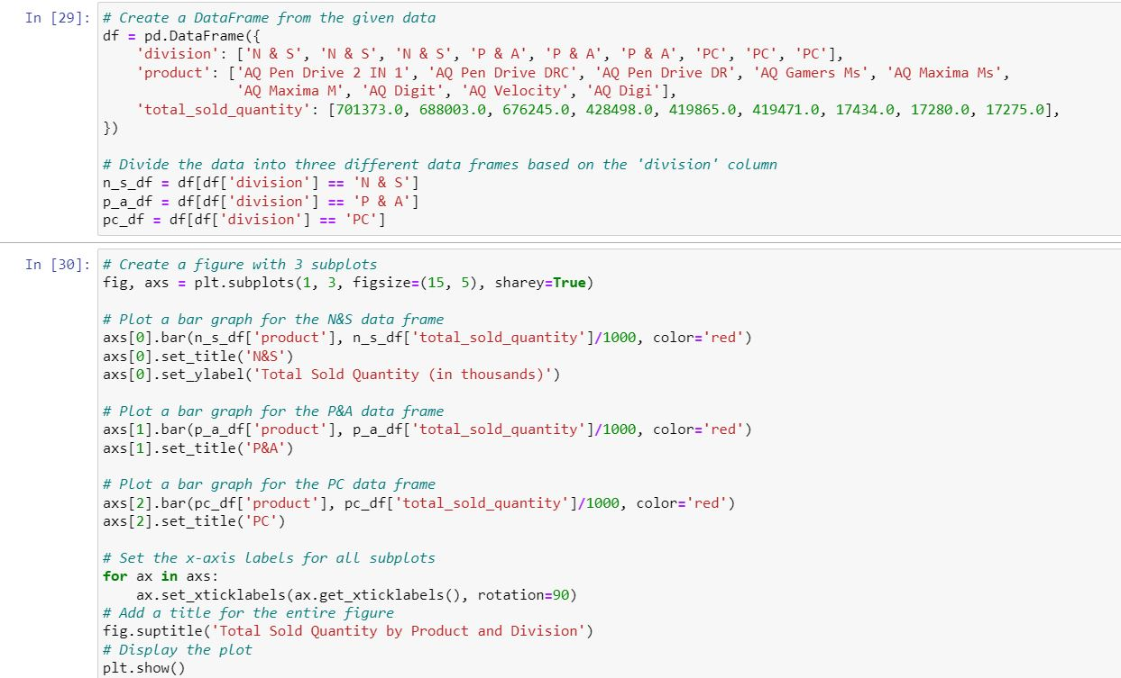
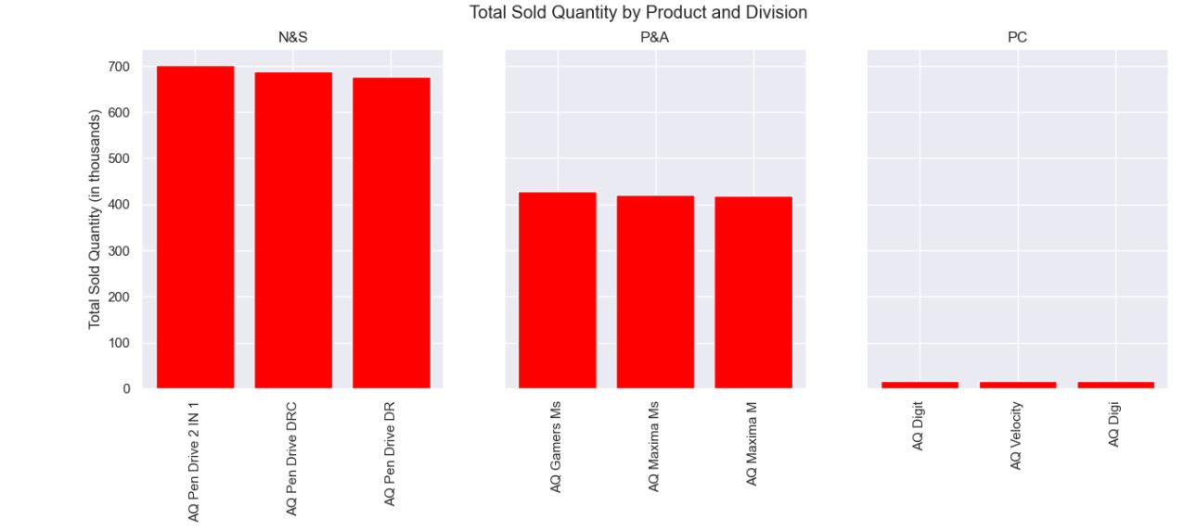

Slide 38
THANK YOU

